Slide 1

Virtual Instrumentation (EEE4035)
Real Time Data Monitoring
of PV Solar cell using LabVIEW
Guided by:
Prof. Abhishek G
Submitted by:
Aamir Kolhar 17BEI0013
Lakshya Porwal 17BEI0034

Slide 2
Abstract
Nowadays, the growing demands of energy, insecure energy resources and emission of hazardous gases have attracted the attention of the whole world towards the renewable energy. Monitoring solar panel output is the best way to track the working of the solar power system continuously. Our project is designed with the help of LabVIEW and DAQ card. The solar panel is connected to the battery and then with sensors. We have connected four sensors with LabVIEW via DAQ hardware to acquire data. This project will be useful power for continually monitoring of solar energy at solar plant.

Slide 3
Introduction
The demand for solar energy is growing on significantly annually. The capability of solar cell is that it can convert into electrical energy from the plentiful and free solar energy. Also, any adverse forms of pollution are not generated which may affect our atmosphere.
Earlier, measuring data continuously was not an easy due to deficiency in advancement of software technology. But, LabVIEW is a national instruments product that we can used to monitor the data for real time applications.

Slide 4
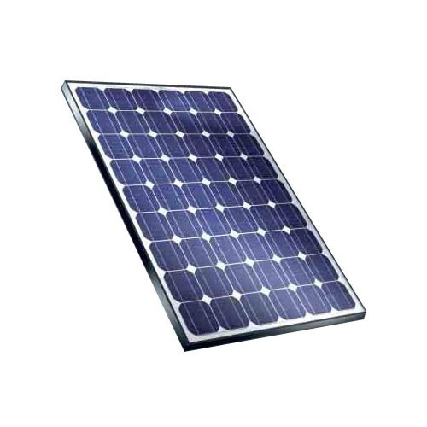
Solar Cell
A solar cell is an electrical apparatus that translates the light energy into electrical energy by the photovoltaic effect.

Slide 5


LabVIEW

Slide 6
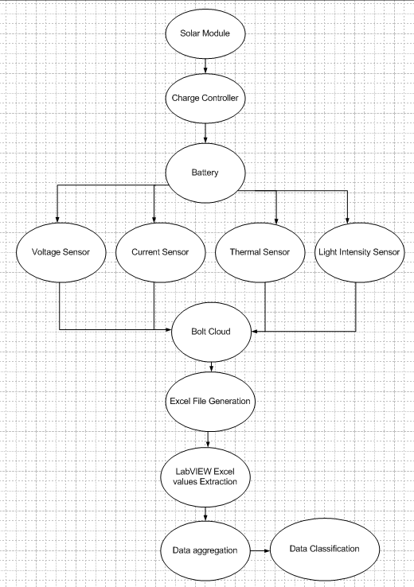
Block Diagram

Slide 7
Working
First of all, the solar module is placed in the open ground for initial charging.
After that, the charge is applied to the various sensors through battery and charge controller.
Here, four sensors, voltage sensor, current sensor, temperature sensor and light intensity sensor are being used.
Then, the output of these sensors is sent on cloud, which generates excel file.
Next, these data is interfaced with LabVIEW, which aggregates and classifies data.

Slide 8
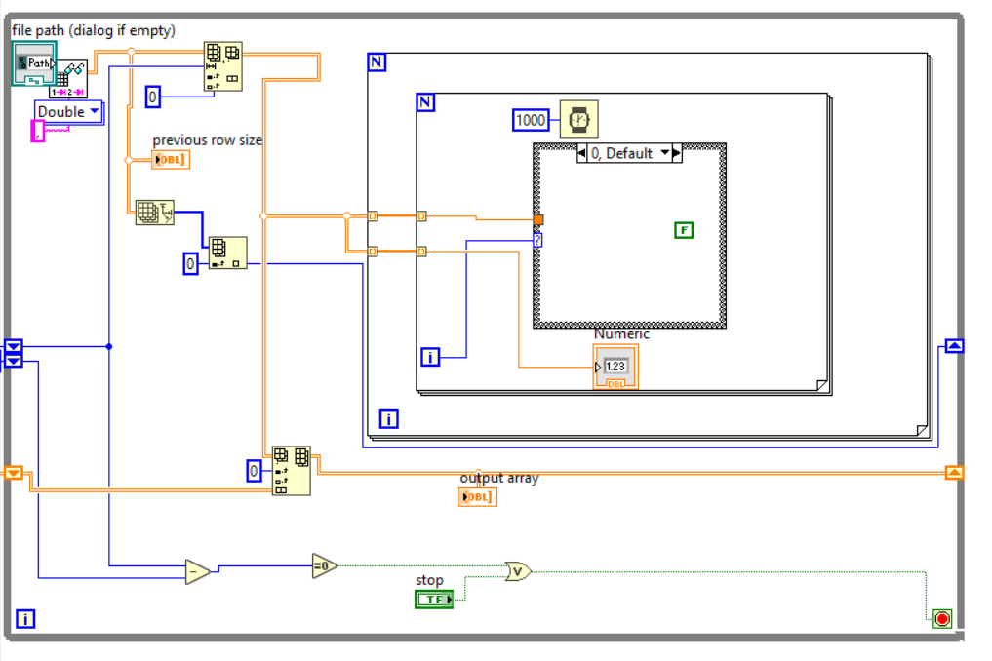
LabVIEW Model1

Slide 9
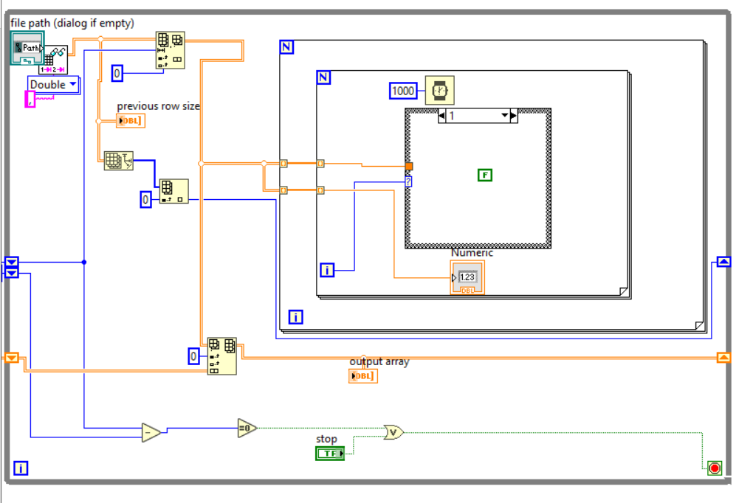
LabVIEW Model2

Slide 10
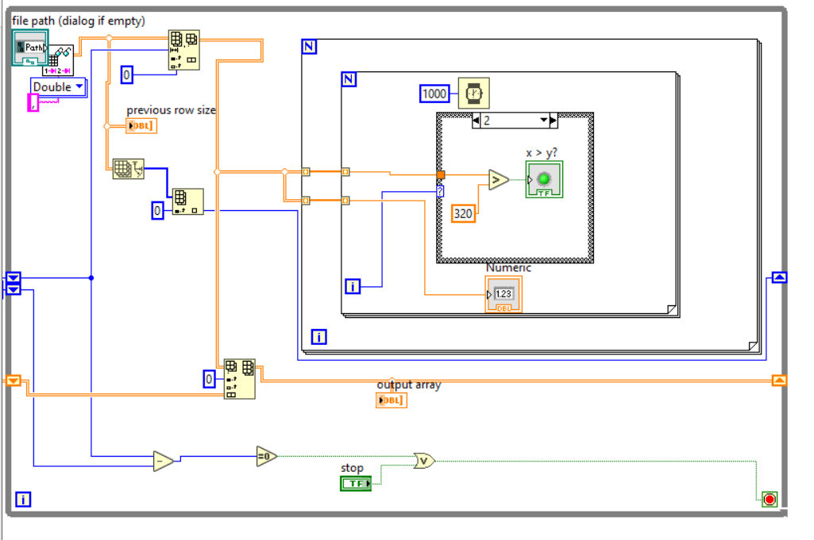
LabVIEW Model3

Slide 11
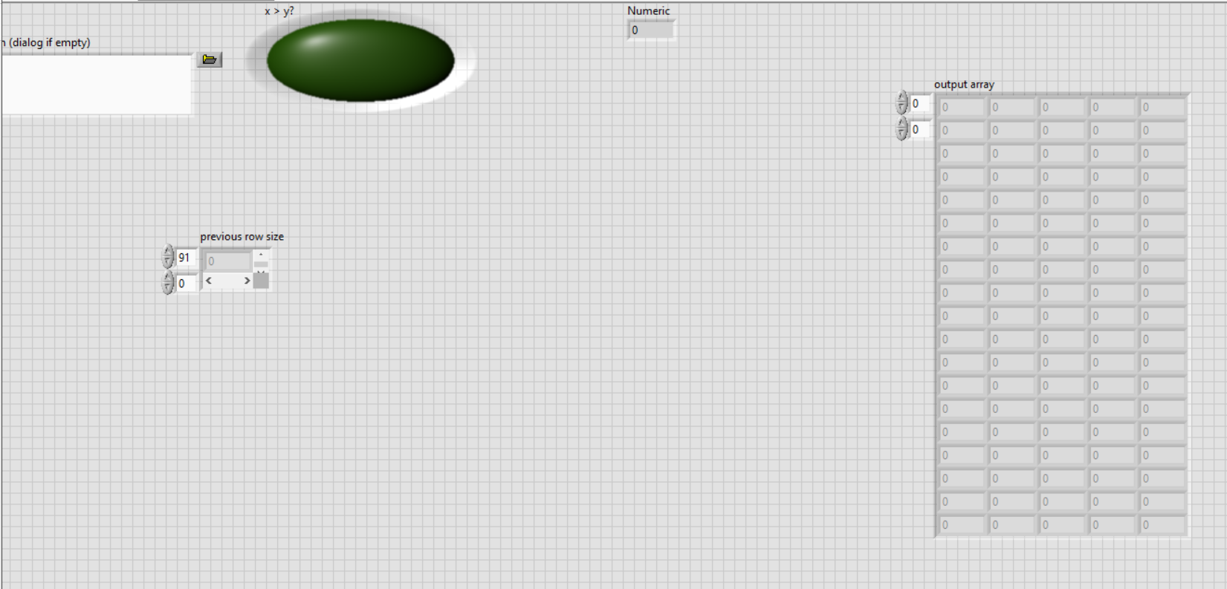
LabVIEW Front Panel

Slide 12


